Slide 1


Deep Space Navigation: A stable space navigation based on X-ray and radio pulsar signals
Chen Jianheng 24097164g
Lin Yi 24127336g
Pan Zhiqing 24037665g
Song Yanlin 24042403g
Zhang Xiaoxun 24070077g
Zhou Kaiwen 24045295g

Slide 2





CONTENT
Purposes of the application
Navigation Requirements
System Design
Analysis on Performances of the Designed system
Other Factors

Slide 3

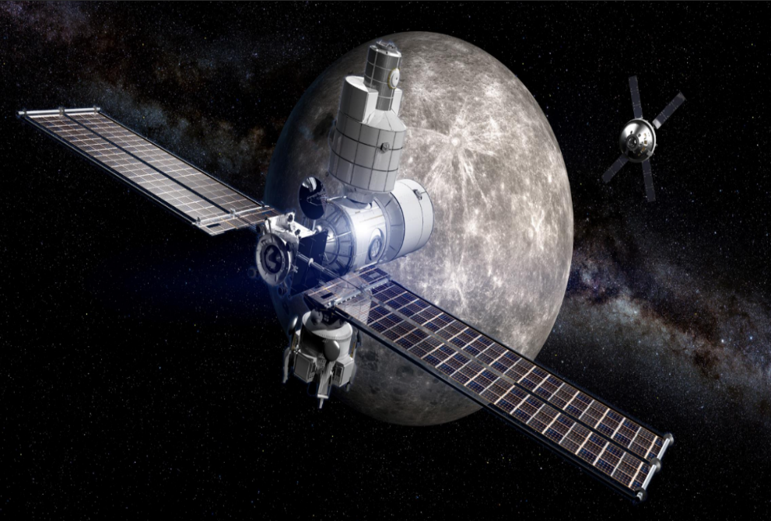
Purposes
Requirements
System Design
Performances
Other Factors
01
Background
Some deep space missions can be enabled or enhanced through the use of autonomous navigation systems.
The most novel ways is to observe and process signals neutron stars.

Slide 4
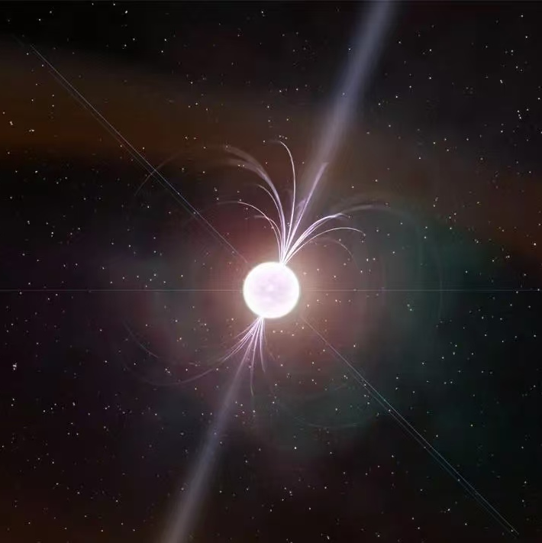
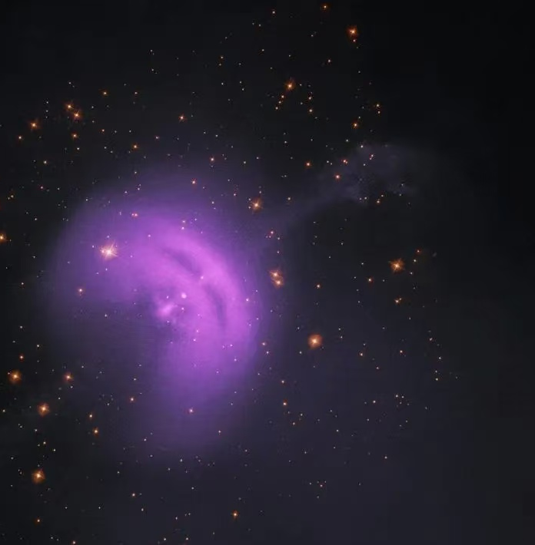
Purposes
Requirements
System Design
Performances
Other Factors
02
Definition
Pulsar navigation is a method for determining the position and velocity of a spacecraft based on the signals emitted by pulsars.
By measuring the time it takes for the pulsar signal to reach the spacecraft, the spacecraft can calculate its position relative to multiple pulsars, thus enabling high-precision, autonomous navigation in deep space far beyond the coverage of the Earth's GNSS system.

Slide 5
Purposes
Requirements
System Design
Performances
Other Factors
03
Structure
Key Modules of Pulsar Navigation
Signal Detection Module
Time Synchronization Module
Positioning Module
Fig. 1-1 Key Modules of Pulsar Navigation

Slide 6
Purposes
Requirements
System Design
Performances
Other Factors
03
Structure
Cosmic Environment Detection Module
Cosmic Large-Scale Observation System (such as gravitational waves)
Medium-Scale (within the stellar system) Observation System
Small-Scale (Planetary) Observation and Navigation System
Database of Observable Celestial Bodies in Large-Scale Cosmic Events
Database of Intra-Stellar Activities
Database of Planetary Activities
Near-Real-Time Signal Exchange Module
Real-Time Signal Exchange Module
Intergalactic Communication Module
Fig. 1-2 Cosmic Environment Detection Module

Slide 7
Purposes
Requirements
System Design
Performances
Other Factors
03
Structure
Basic Cosmic Information Exchange Service
Cosmic Event Trigger Detection and Interpretation Module
Cosmic Consensus Communication Mechanism Based on Large-Scale Observable Events
Cosmic Event Occurrence and Broadcasting System
Pulsar Signal Modulation System
Fig. 1-3 Basic Cosmic Information Exchange Service

Slide 8
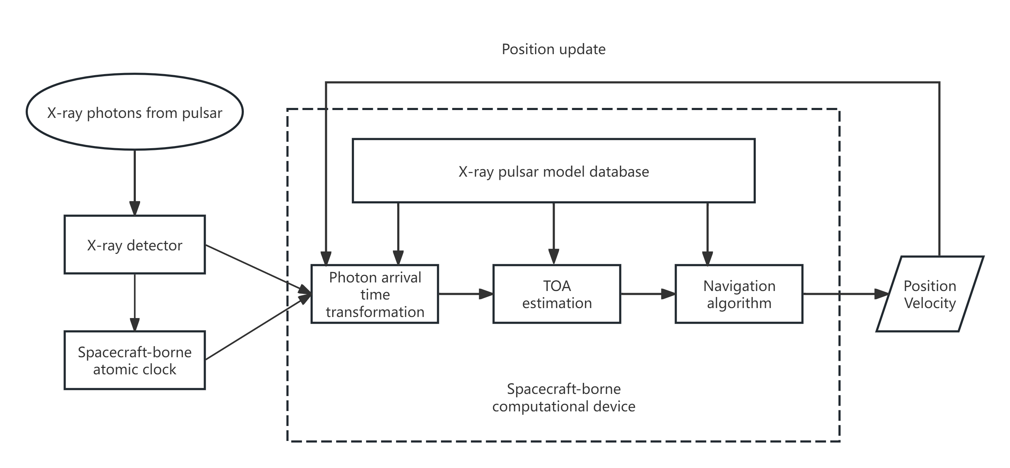
Requirements
Purposes
System Design
Performances
Other Factors
Fig. 2-1 Basic scheme of X-ray pulsar-based spacecraft positioning system

Slide 9
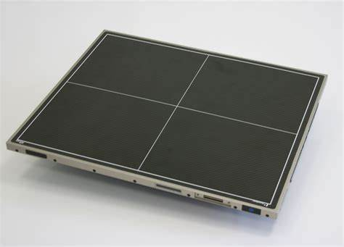
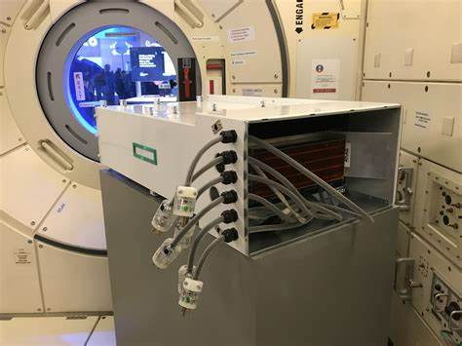
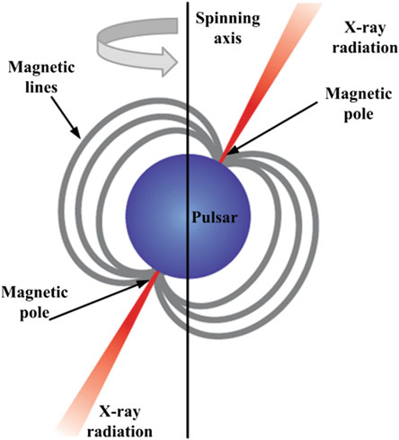
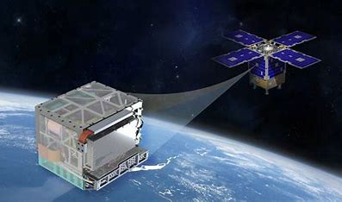
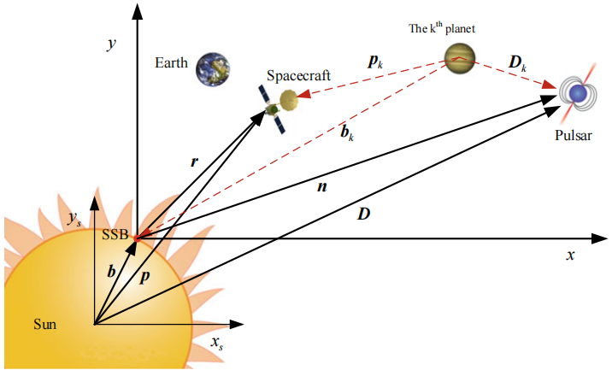
Requirements
Purposes
System Design
Performances
Other Factors
Spacecraft-borne Computational Device
Pulsar Model
Database
X-ray Detector
Spacecraft-borne
Atomic Clock
Navigation Model Algorithms Database
Fig. 2-2 Requirements

Slide 10
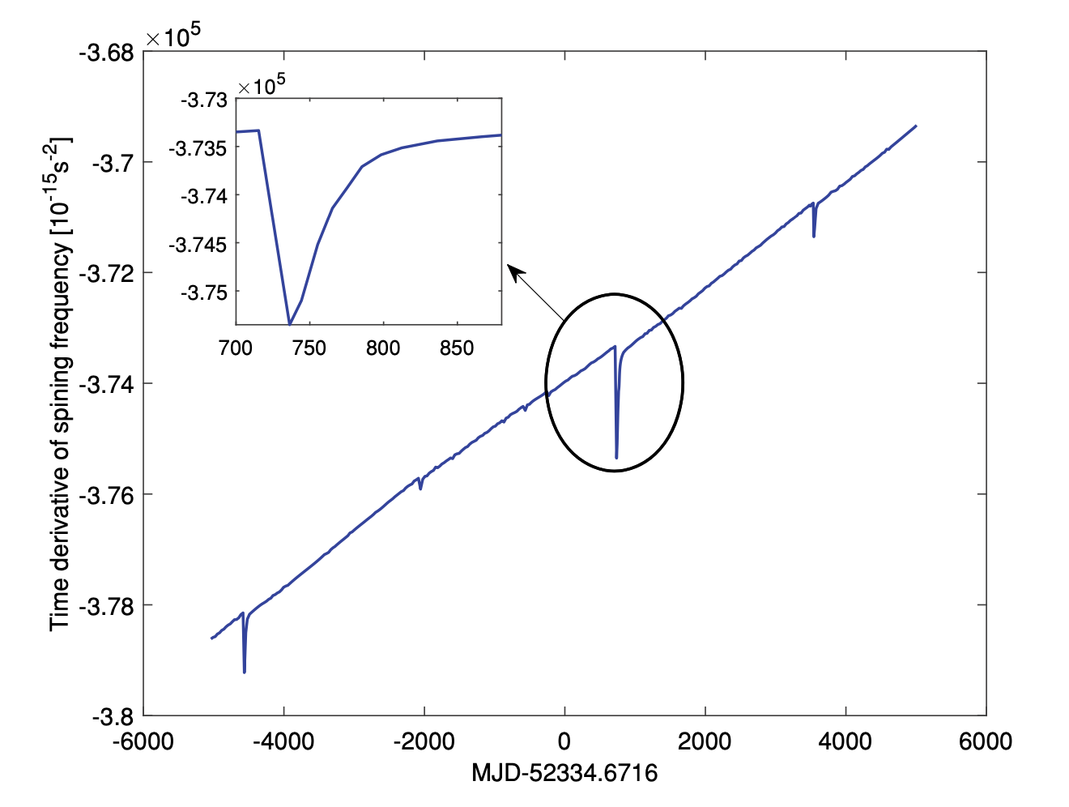
System Design
Purposes
Requirements
Performances
Other Factors
Fig. 3-1 About pulsar

Slide 11
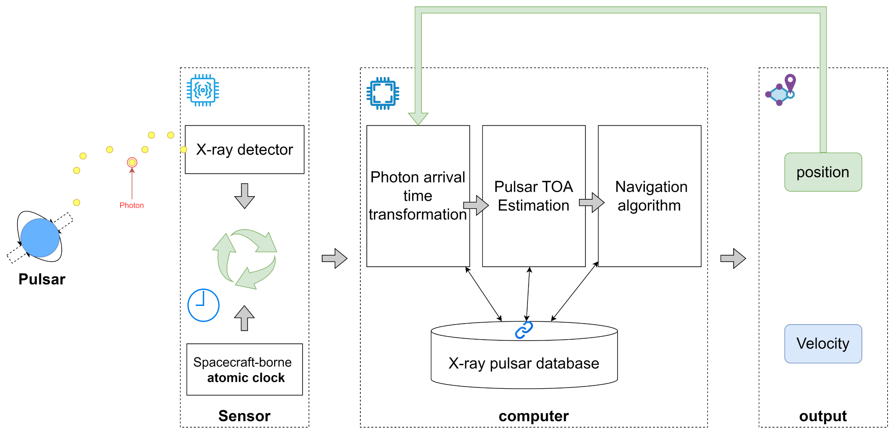
System Design
Purposes
Requirements
Performances
Other Factors
Fig. 3-2 Single System design

Slide 12
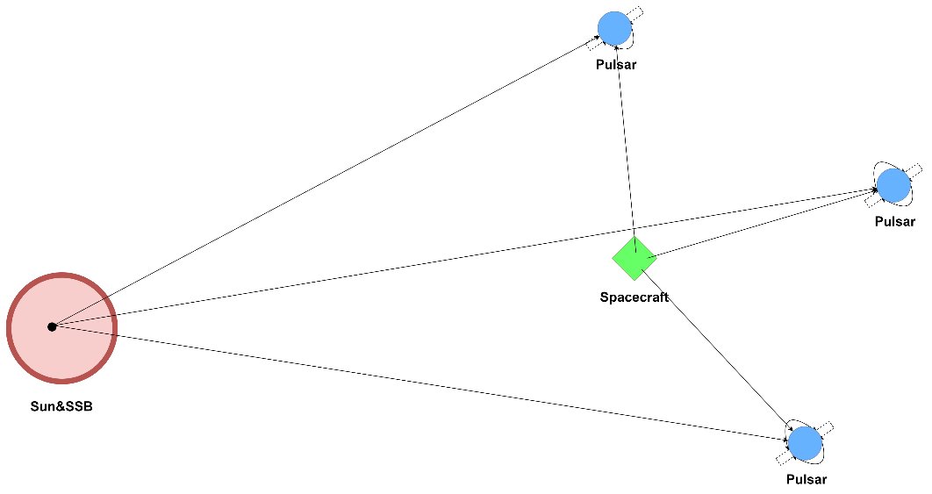
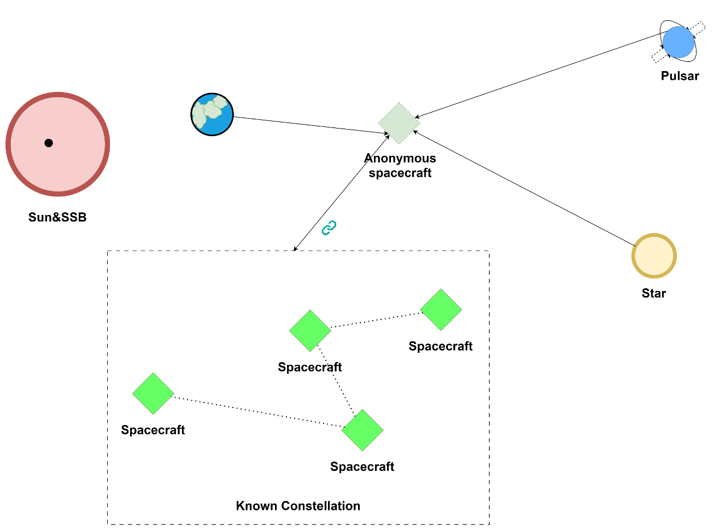
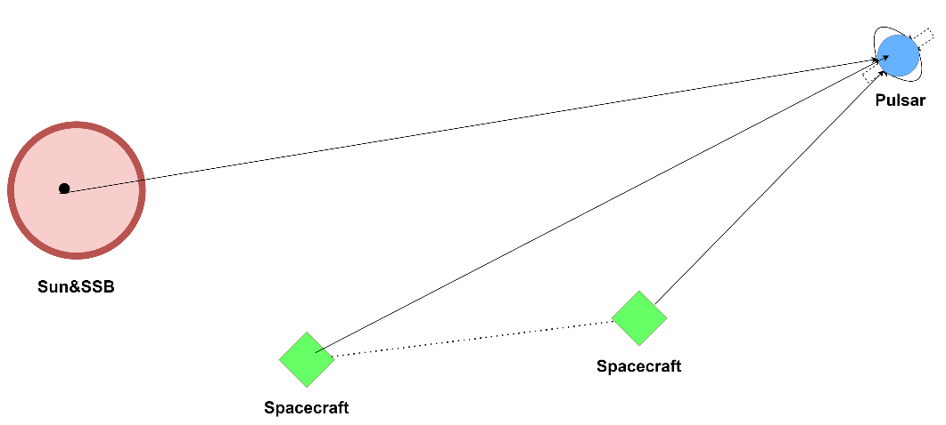
System Design
Purposes
Requirements
Performances
Other Factors
Fig. 3-3 Multi-Navigation Information Source Fusion

Slide 13
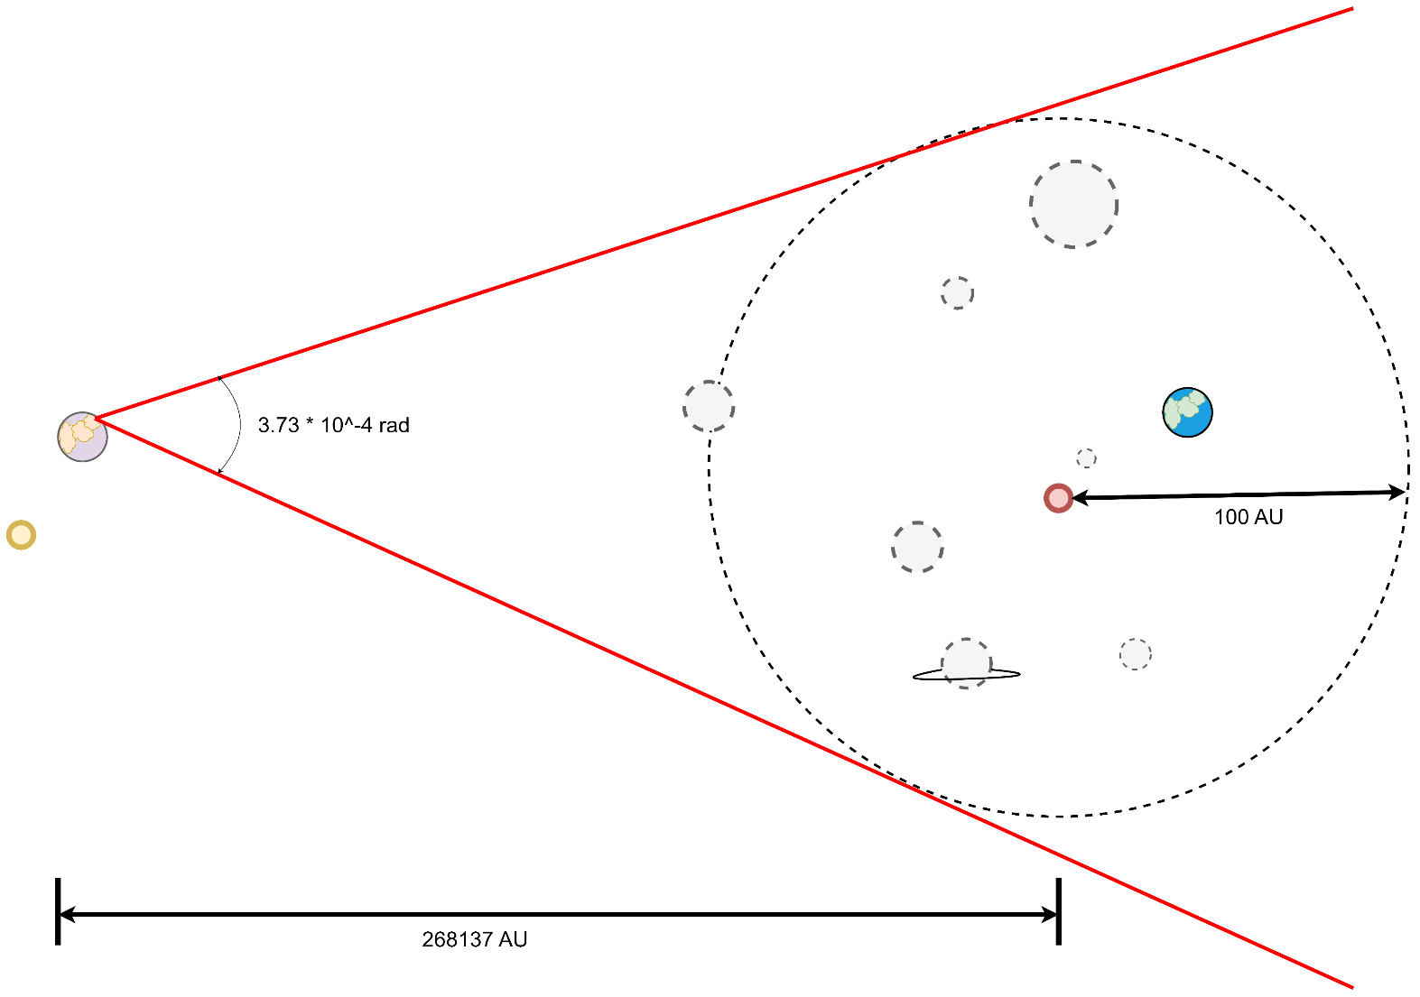
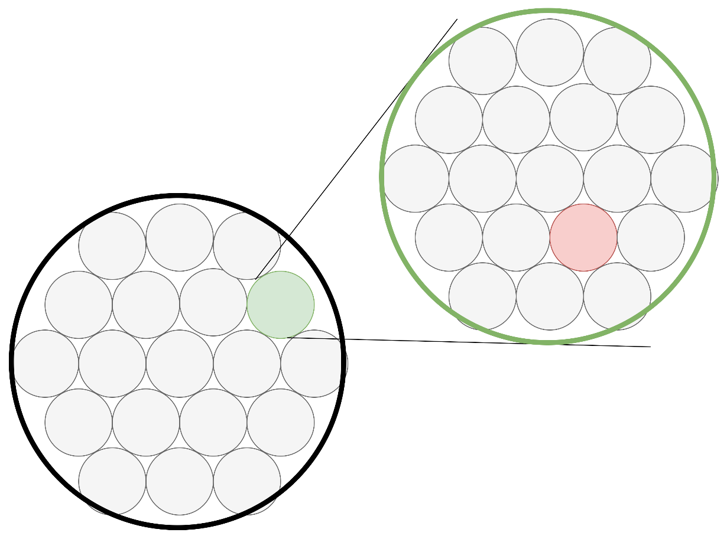
System Design
Purposes
Requirements
Performances
Other Factors
Fig. 3-4

Slide 14
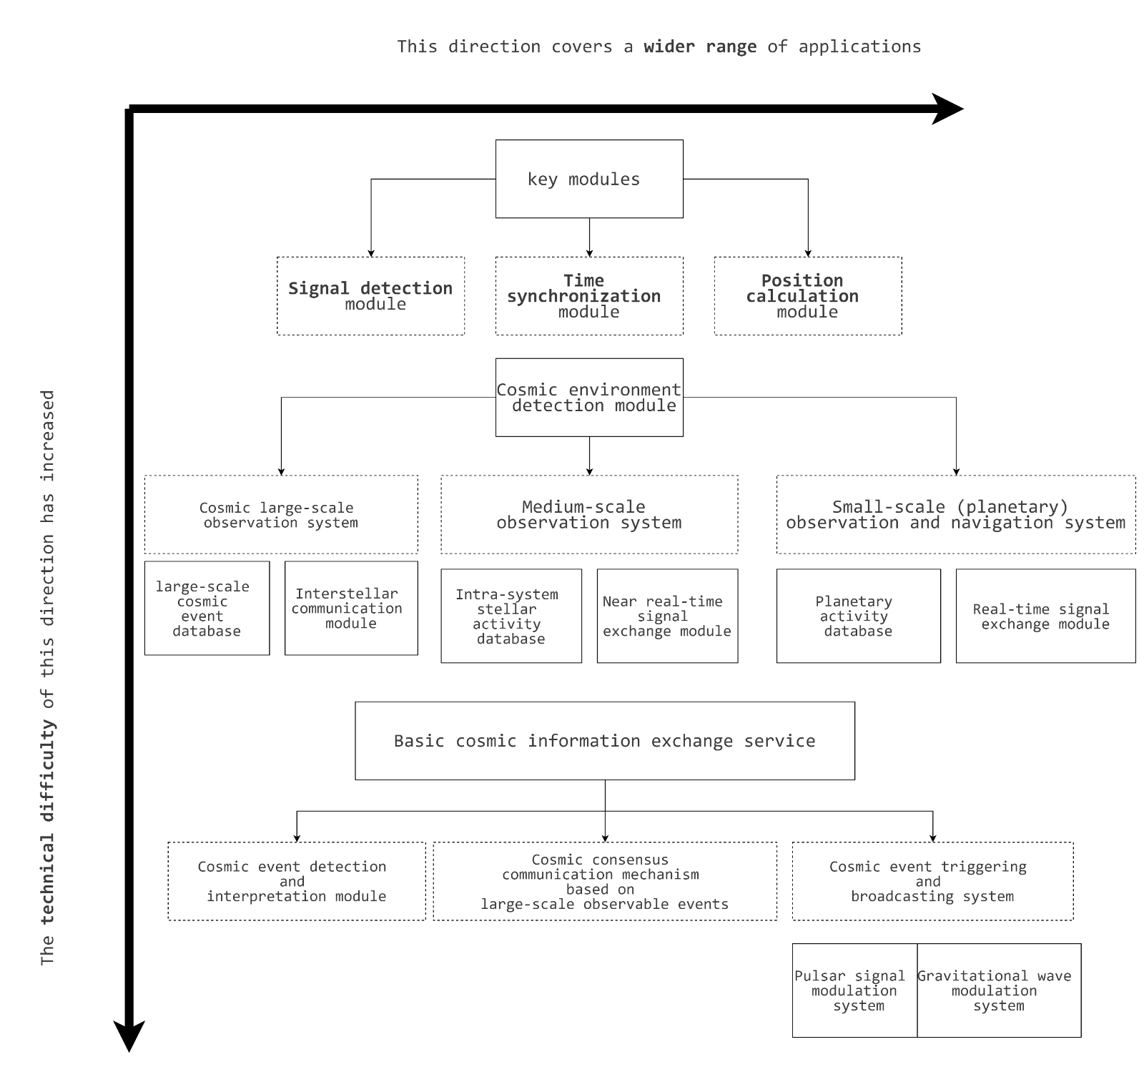
System Design
Purposes
Requirements
Performances
Other Factors
Fig. 3-5

Slide 15
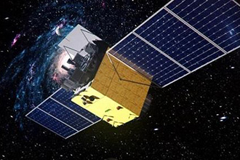
Performances
Purposes
Requirements
System Design
Other Factors
Robustness：
In deep space, satellite navigation systems often face problems such as weak signals and interference, but the signals provided by X-ray and radio pulsars can overcome these problems due to their high stability.
Work stably when it is far from Earth or conventional satellite networks.

Slide 16
Performances
Purposes
Requirements
System Design
Other Factors
Spatial scale | Navigation target motor ability | Navigational use | Minimum accuracy required | Typical application scenarios
Earth and Earth orbit | Subsonic to low-orbit high speed (within 0.01C) | Ground and low-earth orbit navigation | Meters to centimeters | GPS navigation, satellite positioning, ground transportation
Inside the solar system | Low speed to 0.01C | Interplanetary exploration, low-earth orbit missions | kilometer level | Mars exploration, outer planet science mission
Local interstellar space | 0.01c to 0.1c | Interstellar Navigation and Exploration | Kilometers to 100 meters | Extrasolar exploration, nearby star visits
Adjacent galactic regions | Near light speed（0.1c-0.5c） | Intergalactic exploration and astronomical observations | 10,000 km | Exploration and exploration of Proxima Centauri or distant stars
Wide range of galaxies | Close to the speed of light（0.5c-0.9c） | Astronomical observations at a cosmic scale | 100,000 km | Detection near black holes, intergalactic travel
Pan-cosmic scale | Approaching or reaching the speed of light（>0.9c） | Extremely distant galaxies, cosmic deep space navigation | Light grade | Black hole detection, observation of the structure of the universe
Table. 4-1 System core index

Slide 17
Performances
Purposes
Requirements
System Design
Other Factors
Navigation accuracy in the solar system
Local intra-galactic navigation accuracy
Wider area navigation accuracy
Positioning accuracy | The scale of kilometers is several kilometers to tens of kilometers between distant planets | Ideal range from kilometers to tens of thousands of kilometers. If you want to carry out higher precision tasks, it needs to be within tens to hundreds of meters. | It's going to be thousands to tens of thousands of kilometers
Timing accuracy | At least in microseconds and ideally in nanoseconds | Keep it at the microsecond level. In some high-precision interstellar missions, nanoseconds are required. | Needs to be on the microsecond scale

Slide 18
Other Factors
Purposes
Requirements
System Design
Performances
01
Compared to GNSS
In deep space far from Earth, where GNSS is not available due to the inability to rely on ground-based receiver, pulsar navigation can provide spacecraft with autonomous navigation capabilities.
 | GNSS | Pulsar Navigation
Reference Frame | Takes the center of the earth(WGS84 ,GPS) as a reference object. The position of the satellite can be known during navigation. | The center of the Sun is used as a reference object. Position information of the pulsar is not known during navigation.
Signal | Pseudo range and carrier phase | Pulse Frequency & Pulse Phase Observation
Environments effects | Both are similar in that the satellite signals of GNSS are affected by the atmospheric medium. And the X-ray signals of pulsar navigation systems are also affected by the interstellar medium.
Errors | Accuracy of pseudo-range observation at the decimeter level and carrier phase observations at the millimeter level; includes satellite and receiver clock errors, atmospheric delays, code and carrier phase delays, | Errors are related to the pulsar characteristics and the integration time of the observation, with X-ray pulsars having an accuracy of several hundred kilometers for short integration times and under 100 meters for long integration times (more than a week).

Slide 19
Other Factors
Purposes
Requirements
System Design
Performances
02
Future trends
Application Expansion
As the technology becomes more mature, pulsar navigation may be applied to satellite constellations in near-Earth orbit to provide satellites with backup means of navigation and to enhance the stability and anti-interference capability of satellite navigation systems.
Application Expansion
The development of larger-area, higher-sensitivity X-ray detectors and more advanced signal processing algorithms, will allow for more precise measurement of pulse arrival times, thereby improving navigation accuracy.

Slide 20
Thanks!
Q & A
Chen Jianheng 24097164g
Lin Yi 24127336g
Pan Zhiqing 24037665g
Song Yanlin 24042403g
Zhang Xiaoxun 24070077g
Zhou Kaiwen 24045295g

